Slide 1
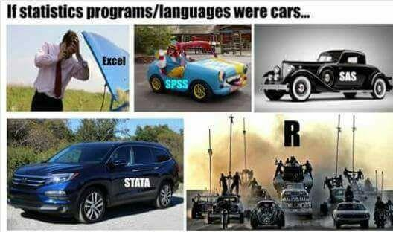
Quantitative Community ecology in R
Instructor: Jesse Miller

Slide 2
Outline
Introductions
Data management & tidy data
Diversity metrics
Distance matrices
Ordination and PERMANOVA
Indicator species analysis
Trait-environment relationships
Phylogenetic diversity analyses

Slide 3
introductions

Slide 4
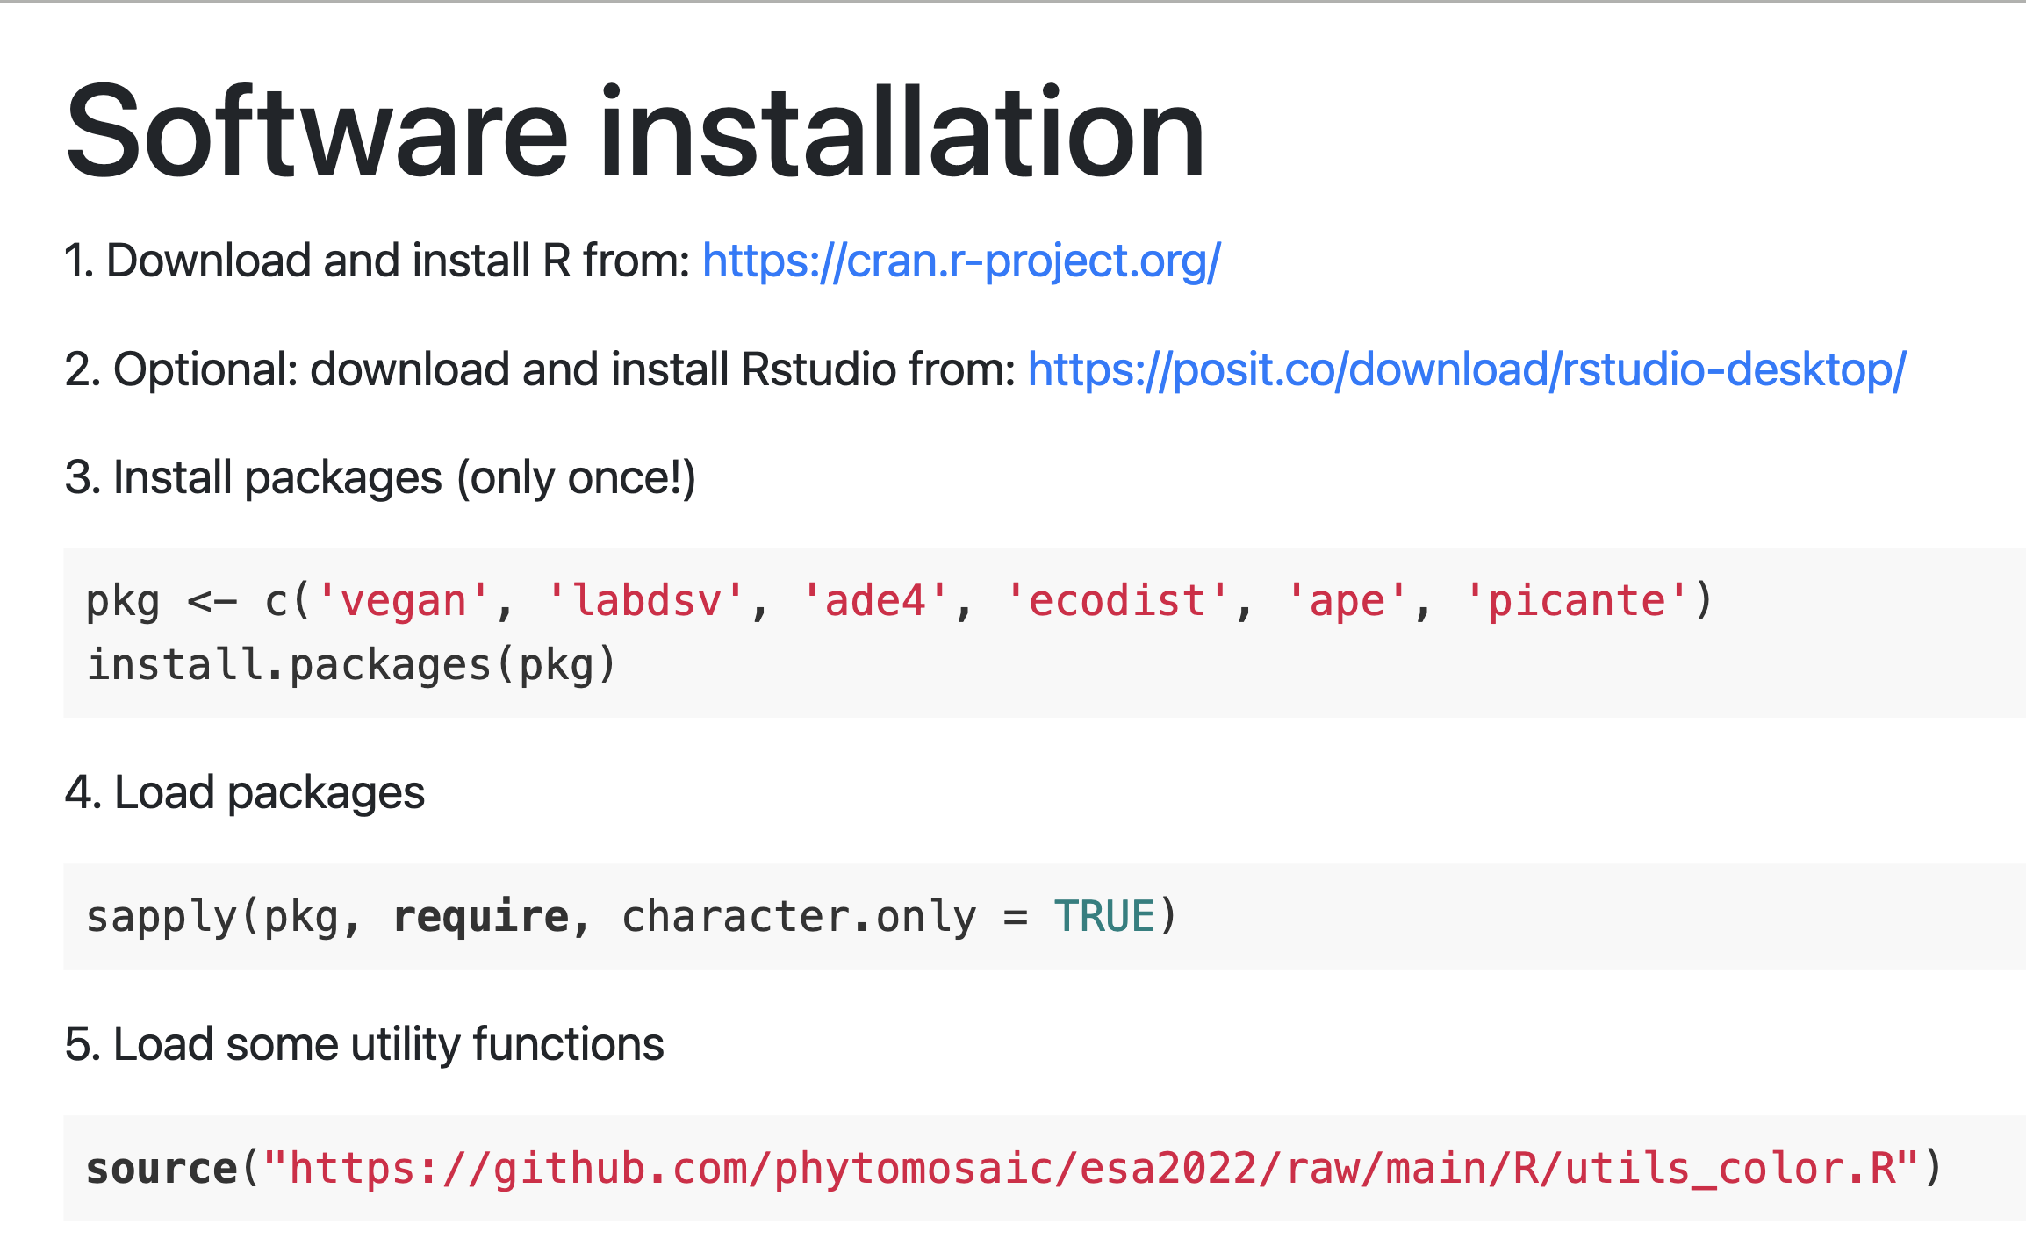

Slide 5
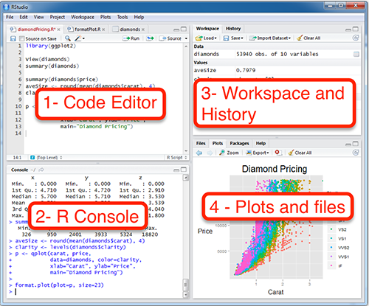
R Studio
Development environment for R
Keeps everything in one big panel instead of separate windows
Sometimes crashes with large datasets

Slide 6
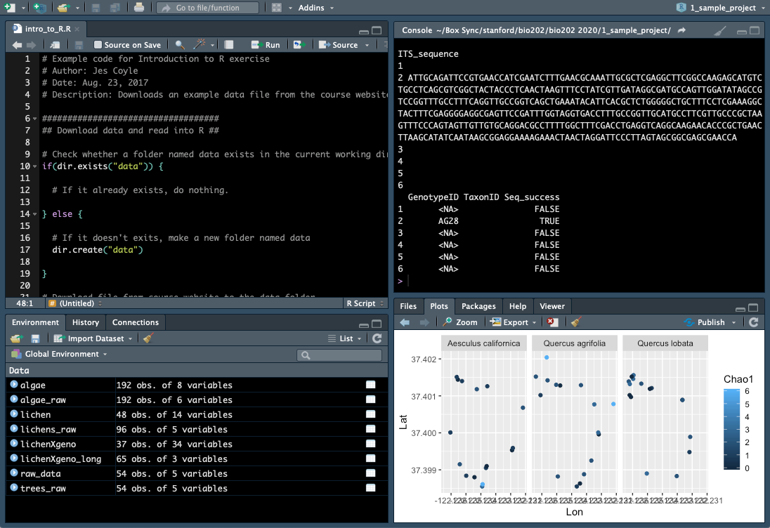
Setting up R Studio
Choose a color scheme (RStudio > Preferences > Appearance)
Consider rearranging windows with console in upper right (RStudio > Preferences > Pane layout)

Slide 7
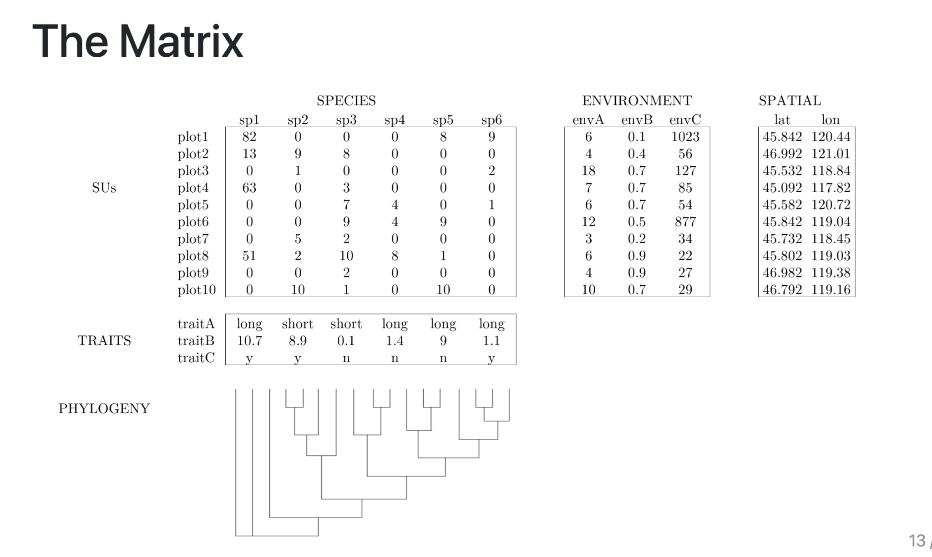
The three data matrices of community data

Slide 8
The three data matrices of community data

Slide 9
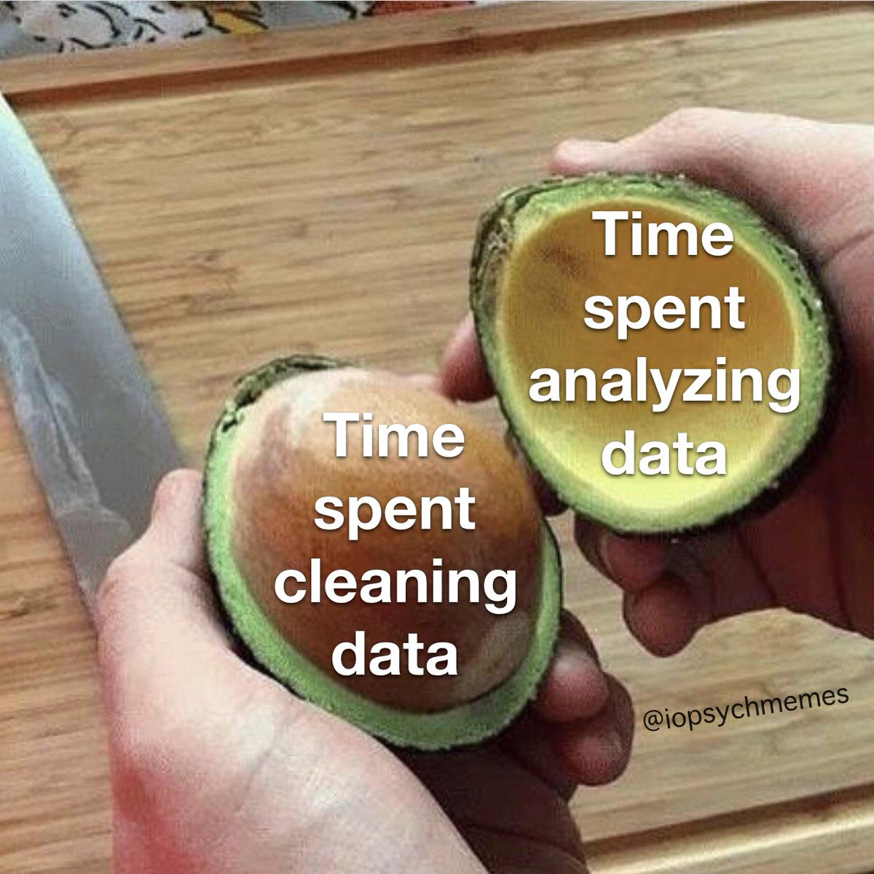
Tidy data
1. Each variable is a column; each column is a variable.
2. Each observation is a row; each row is an observation.
3. Each value is a cell; each cell is a single value.

Slide 10
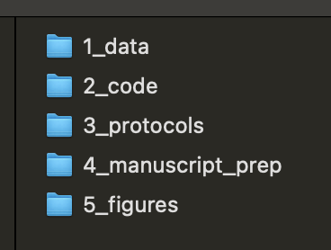
Managing community data
Keep all files for a project in subfolders of the same folder
Use cloud storage / automatic backup software so your data is always passively backed up
Consider at least one external hard drive too

Slide 11
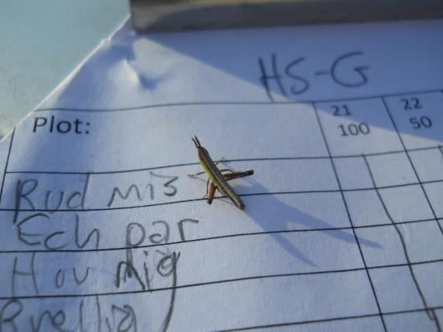
Always keep the original, raw data

Slide 12
Use descriptive names for your data files
‘Corvallis_VegBiodiv_2007’ better than ‘Year1’…

Slide 13
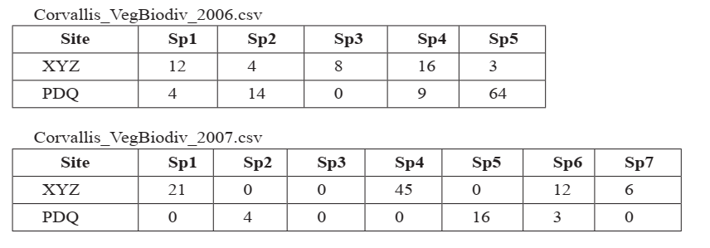
When you add data to a database, try not to add columns. Add rows.
Bad example

Slide 14
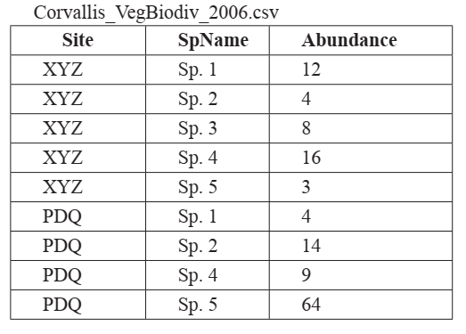
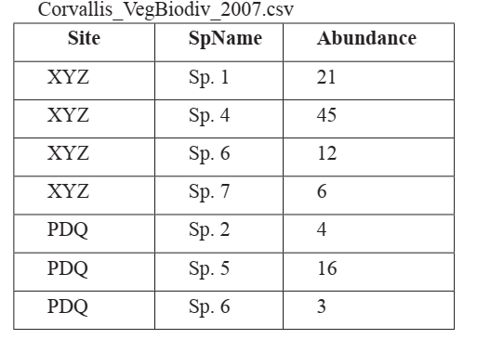
When you add data to a database, try not to add columns. Add rows.
Good example

Slide 15
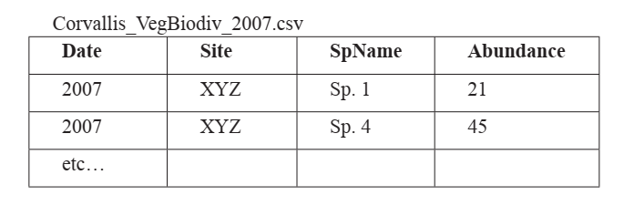
When you add data to a database, try not to add columns. Add rows.
Best example

Slide 16
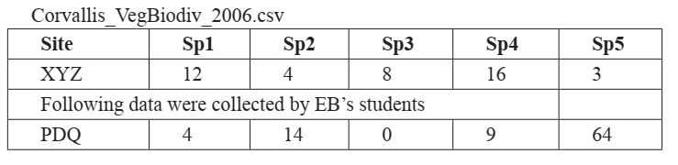
All cells within a column should contain only one type of information (text or numerical)
Ex: Don’t enter 40? as a data value. Enter 40 and add a note in a separate column.

Slide 17
Record a single piece of data only once.
Separate information collected at different scales into different tables.
Create a “relational database” (AKA tidy data)

Slide 18
Record a single piece of data only once.
Benefits of relational databases (AKA tidy data)
Reduce wasted space
Avoid structural changes
Easy to add sites, species, plots, etc. without restructuring the file
Reduce redundant data entry/information
Make querying easier
Reduce changes for inconsistent data
Disaggregate data
Site = “San Miguel”, Plot = “a” better than Site = “San Miguel-a”

Slide 19
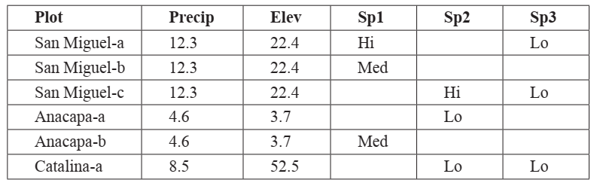
Record a single piece of data only once.
Not-so-good example

Slide 20
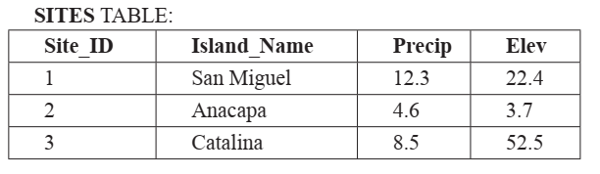
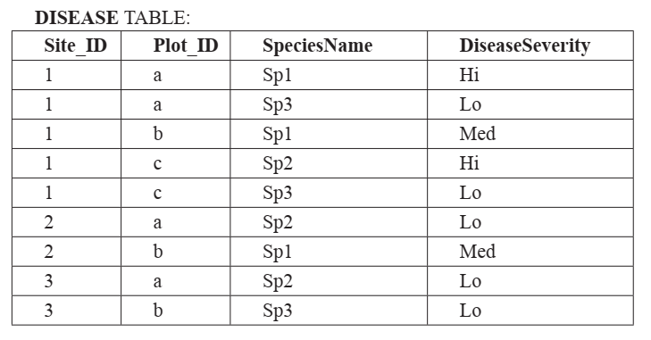
Record a single piece of data only once
Better example

Slide 21
R projects (.Rprj files) make life easy
Eliminate need to set working directory manually
If you move your project folder to a different folder hard drive, or computer, the R project will run seamlessly
.Rproj file extension

Slide 22
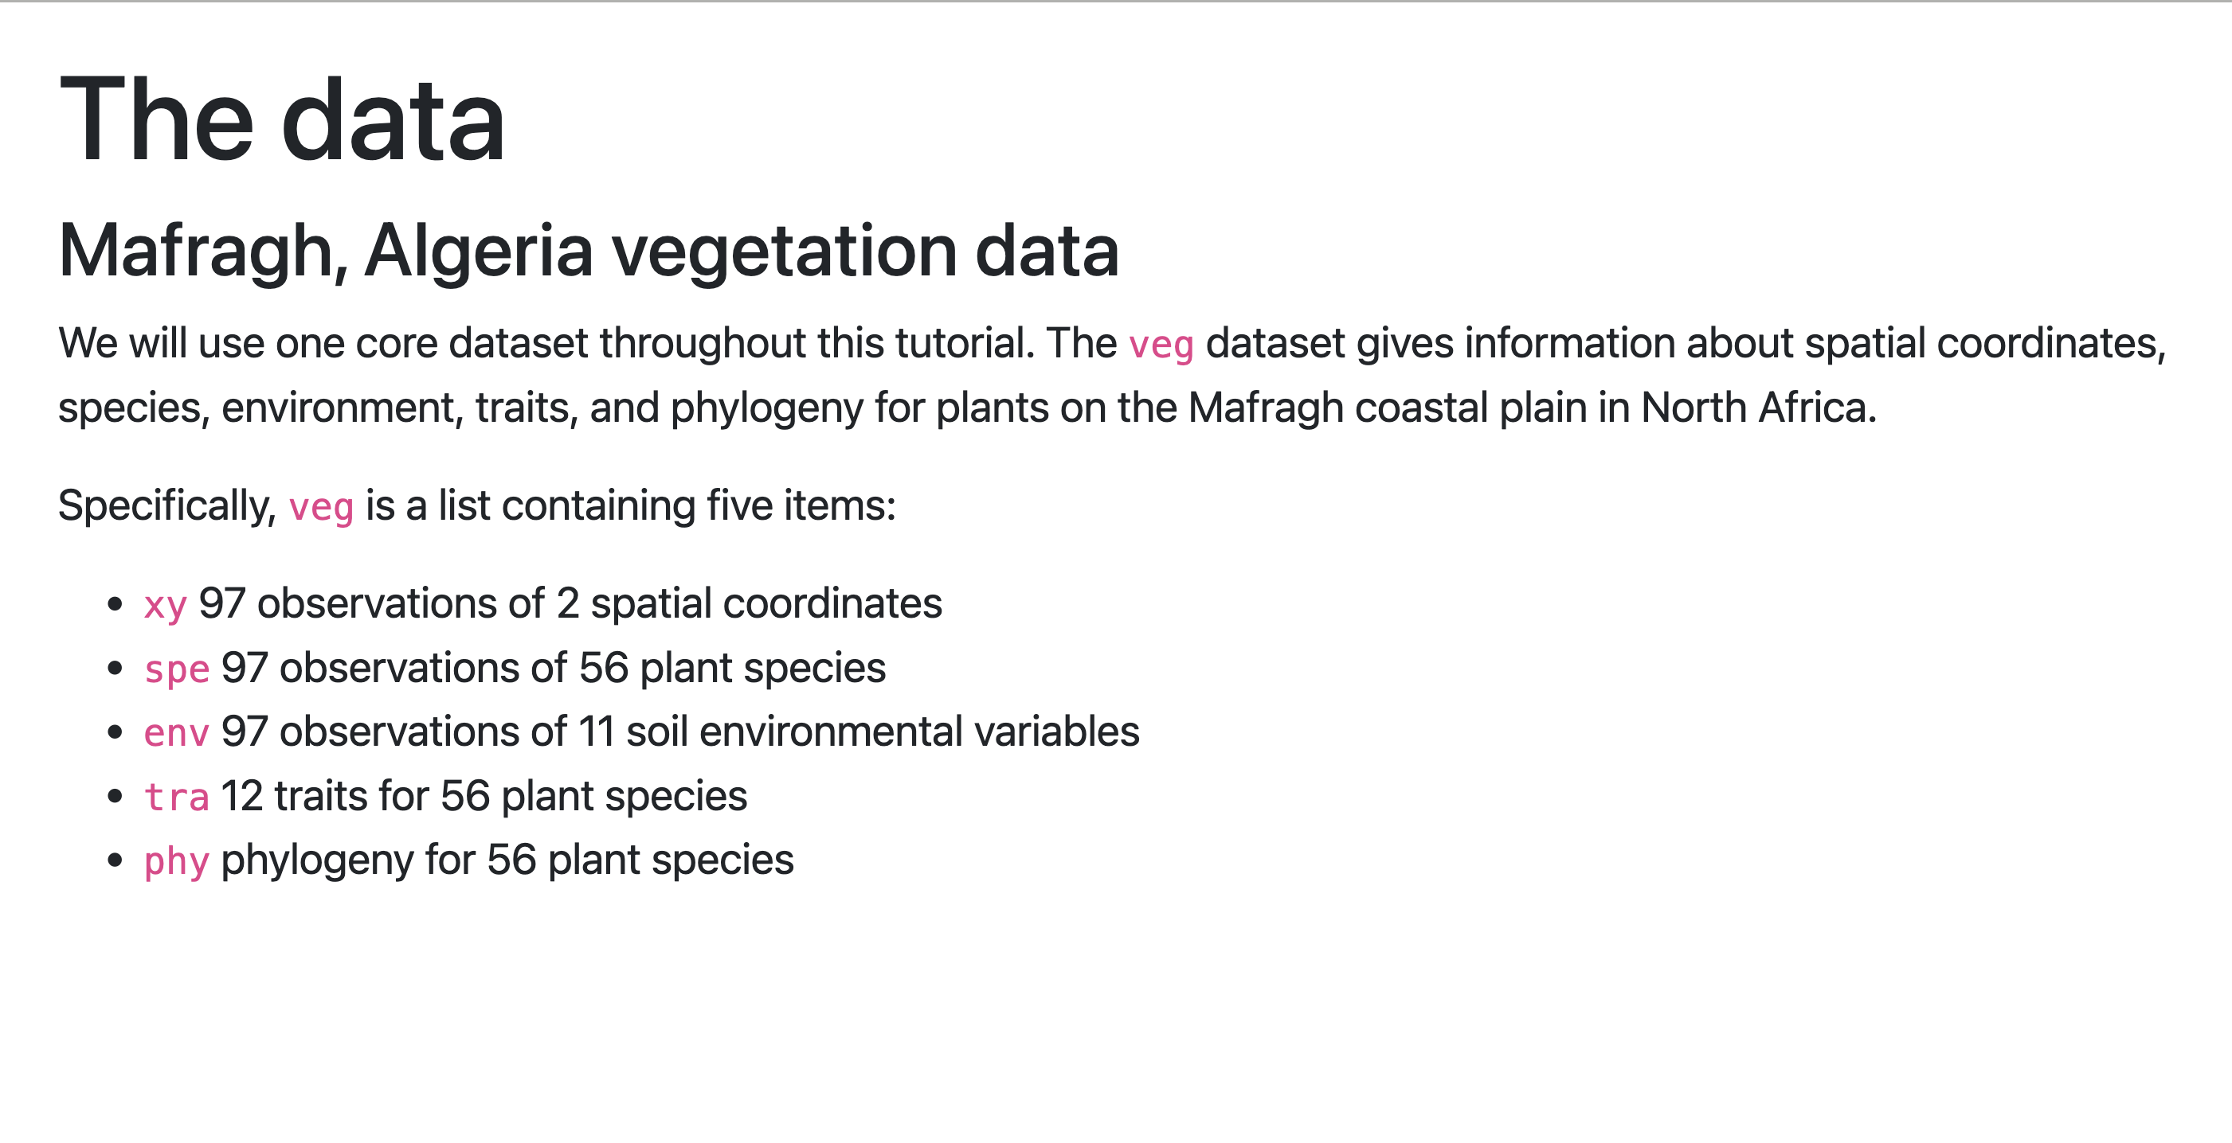

Slide 23
Community metrics
Individual variables that are calculated from a community dataset
Can be analyzed using simple statistics (e.g., linear models) rather than multivariate stats
Examples: Species richness, gamma diversity, community-weighted trait means (but be cautious with the latter)

Slide 24
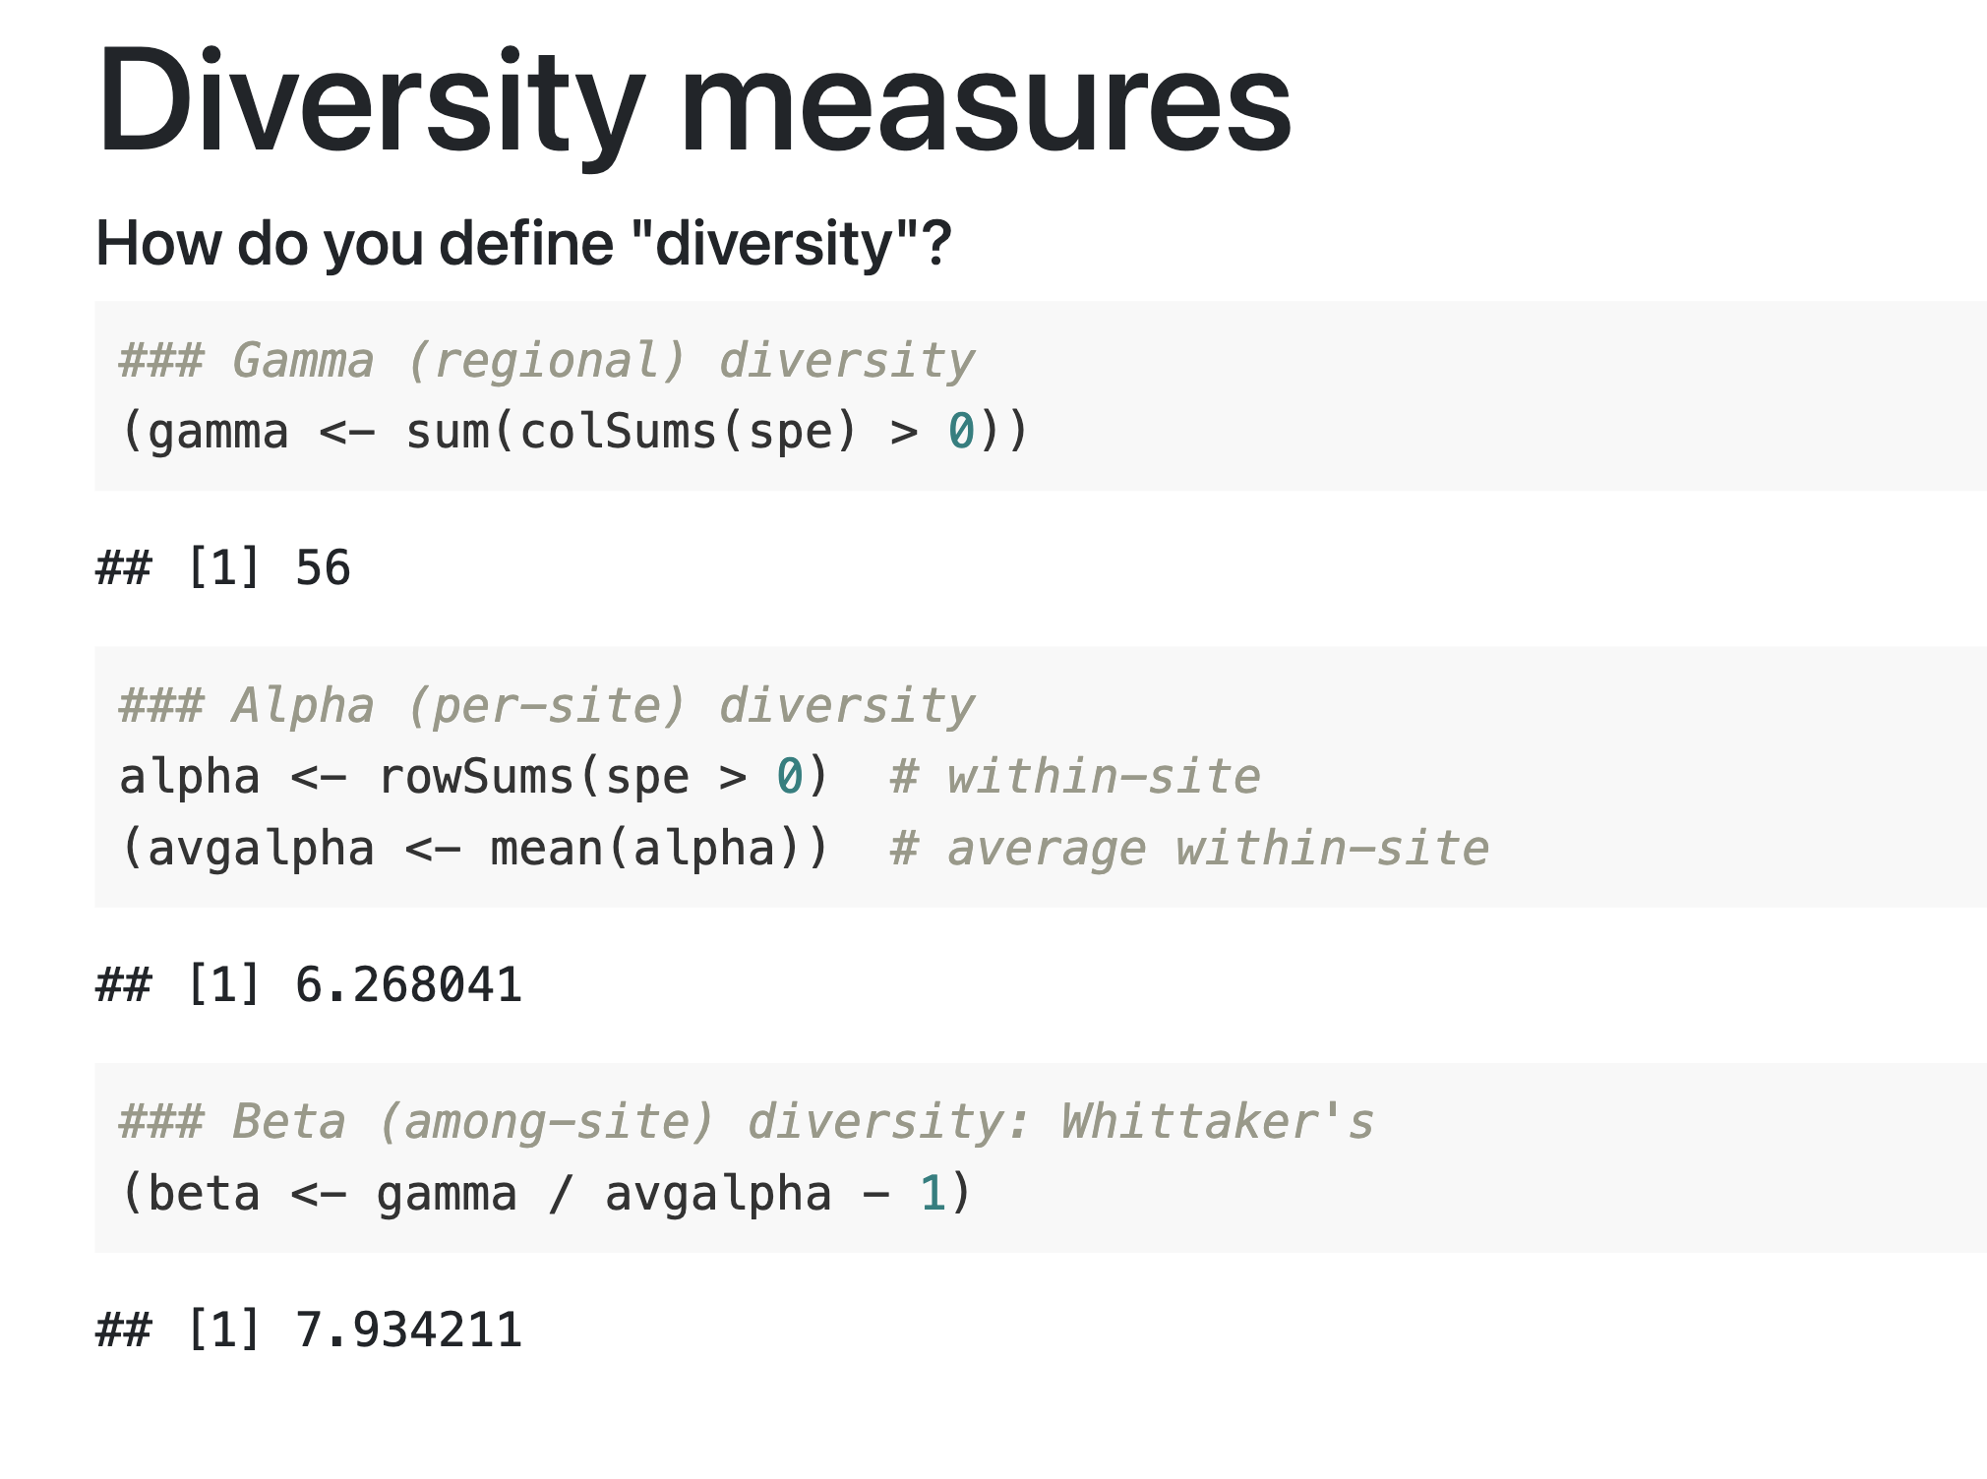
Diversity metrics

Slide 25
Alpha diversity activity
Questions:
Is species richness an informative metric?
How is potassium affecting plant communities?

Slide 26
Further reading on diversity metrics
Whittaker, 1960. Vegetation of The Siskiyou Mountains. Ecological Monographs
Coined terms alpha, beta and gamma diversity
Anderson, 2010. Navigating the multiple meanings of β diversity: a roadmap for the practicing ecologist. Ecology Letters

Slide 27
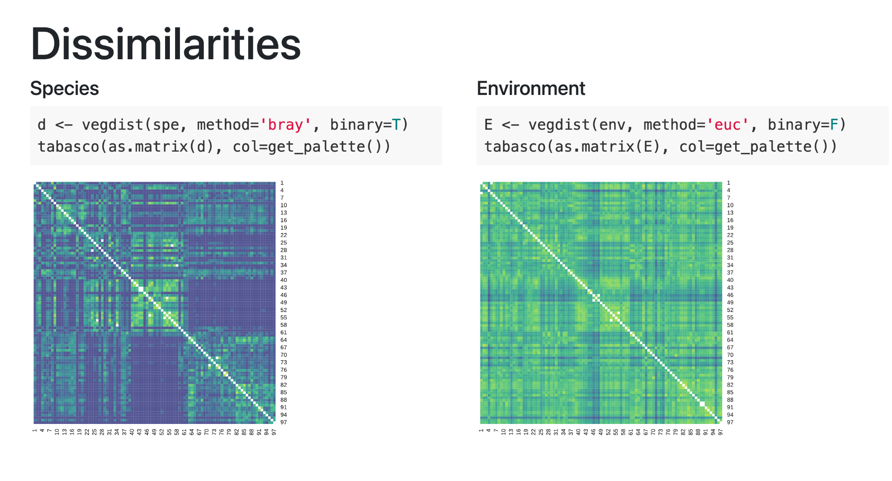

Slide 28
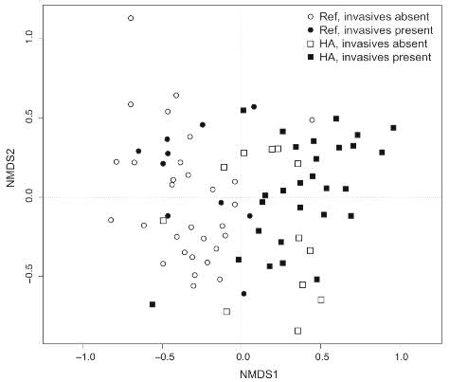

Ordination
"Ordination primarily endeavors to represent sample and species relationships as faithfully as possible in a low-dimensional space" -- Gauch (1982)
THIS
NOT THIS
The Ordination. Nicolas Poussin. 1647

Slide 29
We wanted to liberate people's thinking about vegetation so that they would stop thinking in Clementsian terms, which some in the environment and conservation movements still do today.
-J. Roger Bray, on the development of Bray-Curtis Ordination, 1982

Slide 30
Abundance of Ung.

Slide 31
Abundance of Ung.

Slide 32
Abundance
of Dothiorella
Abundance of Ung.

Slide 33
Abundance
of Dothiorella
Abundance of Ung.

Slide 34
N-dimensional space
N= number of plants
in community
Abundance
of Dothiorella
Abundance of Ung.

Slide 35
Unconstrained ordination
Constrained ordination
Examples: NMDS, PCoA, PCA
Points are placed solely based on species composition
Good for data exploration
A follow-up analysis can be used for hypothesis testing (e.g., permanova)
Examples: (db)RDA, CCA
Points are placed based on species composition and environment
Good for hypothesis testing; no second step needed
“Model-based” approaches are more customizable

Slide 36
Unconstrained ordination
NMDS (Non-metric multidimensional scaling)
A good general-purpose option, diagrams look good
Flexible, doesn’t assume normality, good for community data
PCA (Principal Components Analysis)
Assumes normality, can give “boomerang shape” when data don’t meet assumptions
Good for combining multiple variables into one-few axes
PCoA (Principal Coordinates Analysis)
Good if you need to extract scores for addt’l analysis
Diagrams often look weird

Slide 37
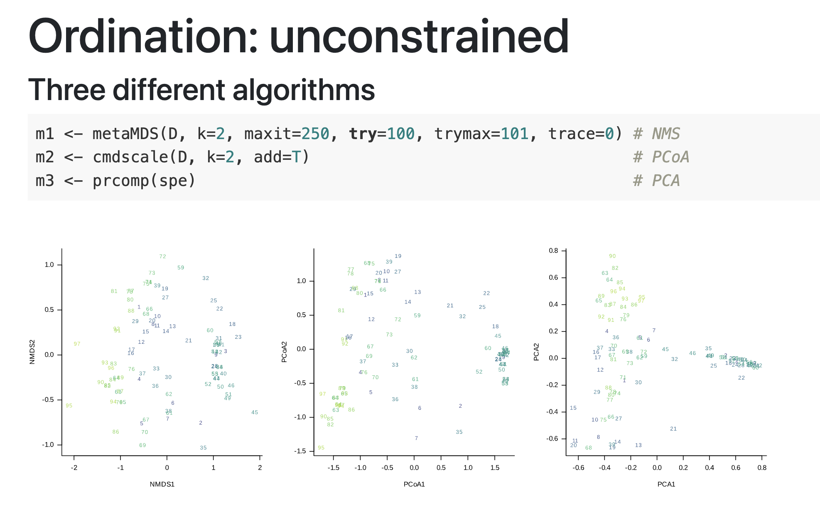

Slide 38
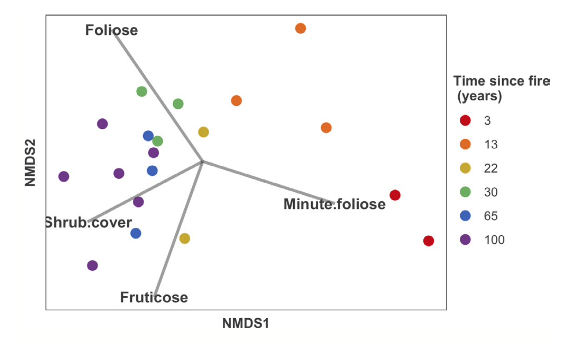
Miller et al. 2022, Diversity and Distributions

Slide 39
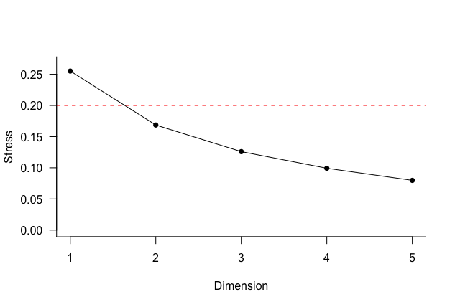
NMDS ordination
“Stress” is a measure of error in the solution
Lower stress is better
Ordination is considered not useful above stress of 0.2
Adding more dimensions to the solution reduces stress
Rule of tumb: add a dimension if it reduces stress by at least 0.05
Can use a scree plot to make this decision

Slide 40
Imagine the sample units as a point cloud.
We could view this point cloud from many different vantage points.
For example, we could view it from a spot where we see as much of the variation as possible – an unconstrained ordination is showing us the view from this spot.
Now imagine that the points are colored to reflect different groups.
Depending on where we view the point cloud from, these groups might appear more or less discrete.
A constrained ordination shows us the view from the spot where the groups are as distinct as possible..

Slide 41
Constrained ordination
rbRDA (distance based redundancy analysis)
Traditional RDA only allowed Euclidian distances, which are not well-suited to community data
rbRDA allows you to use several distance metrics
Traditionally, Bray-Curtis distance for abundance data and Jaccard/ Sorenson distance for presence / absence data
But robust Aitchinson may perform better
MLMs (see papers by Tony Ives)
Other methods include CCA, traditional RDA (not covered here)

Slide 42
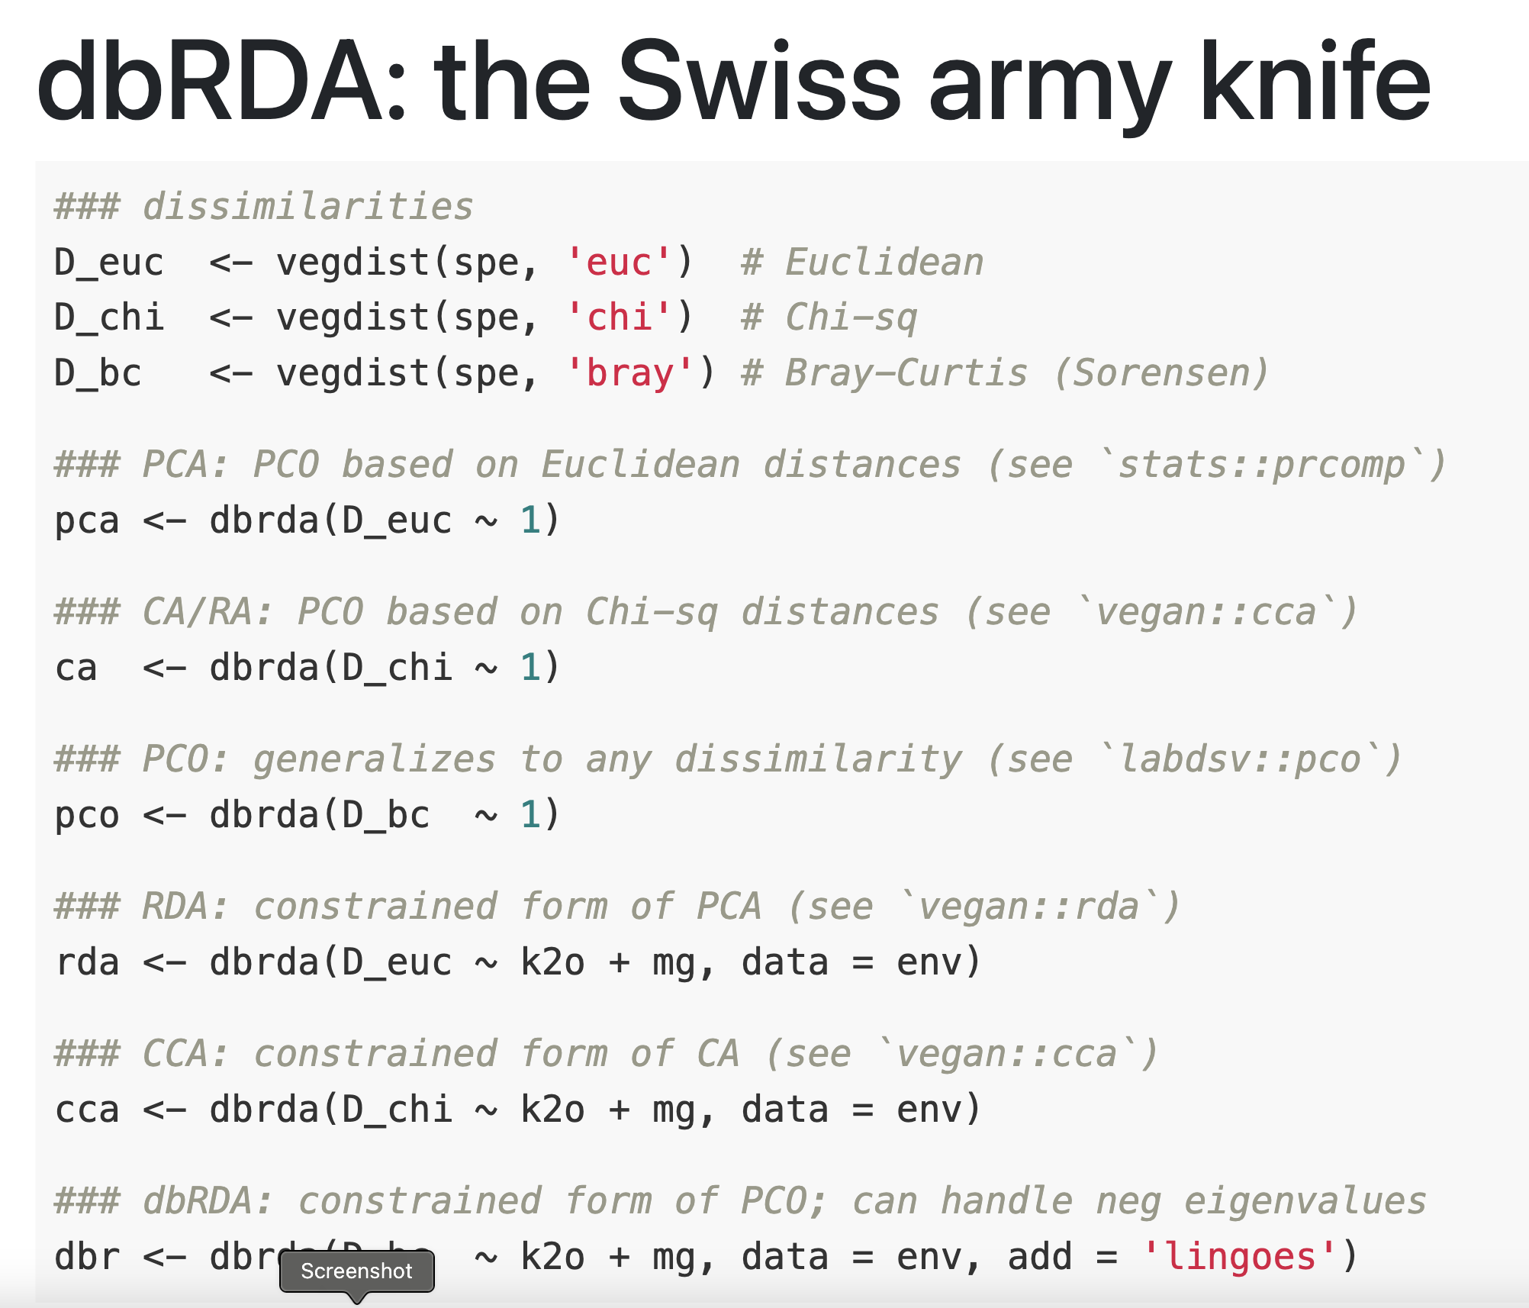

Slide 43
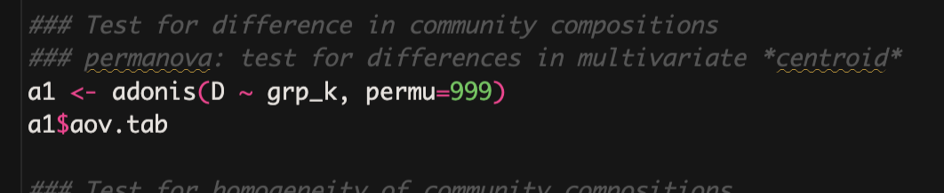
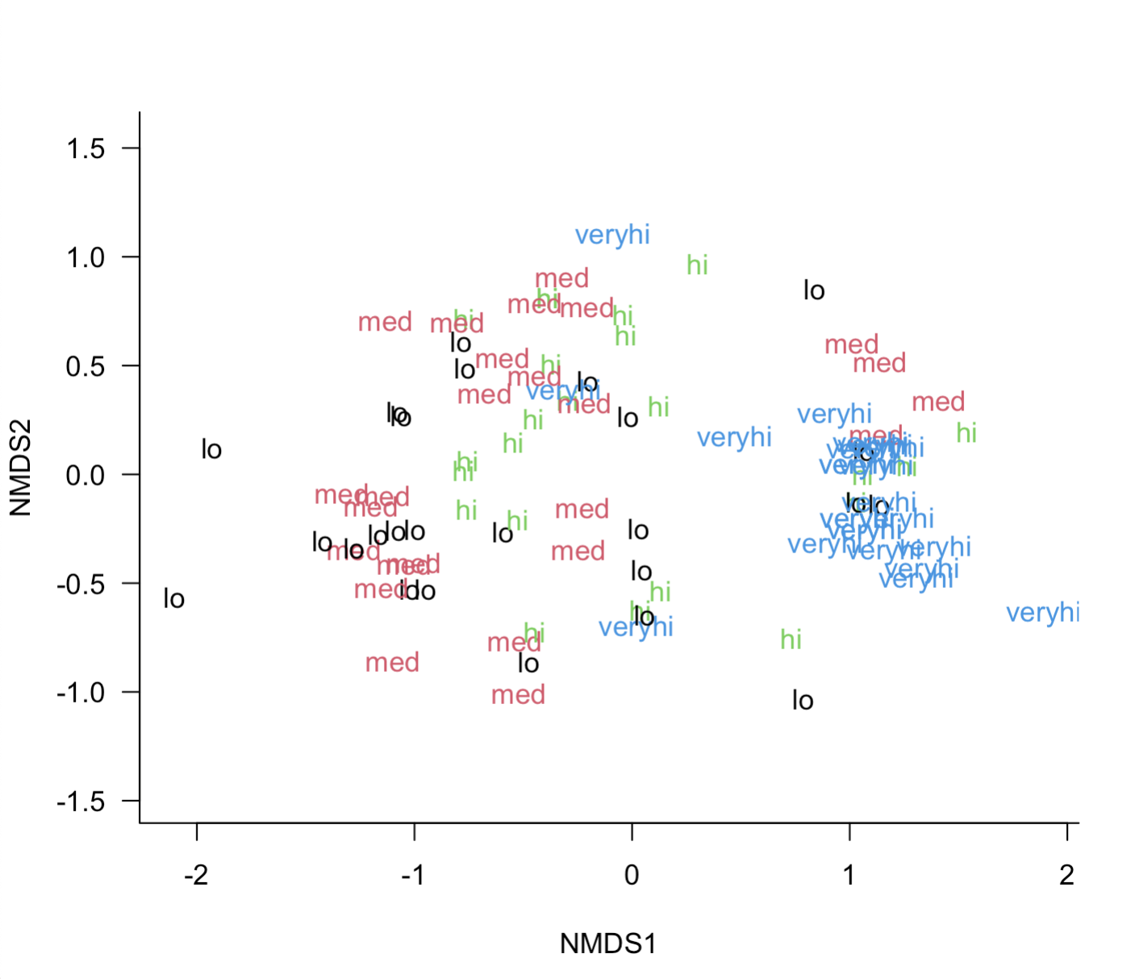
Group differences - PERMANOVA
Tests for differences in centroids; e.g., are groups significantly different in species composition?
Example: separating plots into four groups based on quartiles of K levels (low, med, high, very high)
Syntax is similar to linear models:
Species.matrix ~ Predictor1 + Predictor2

Slide 44
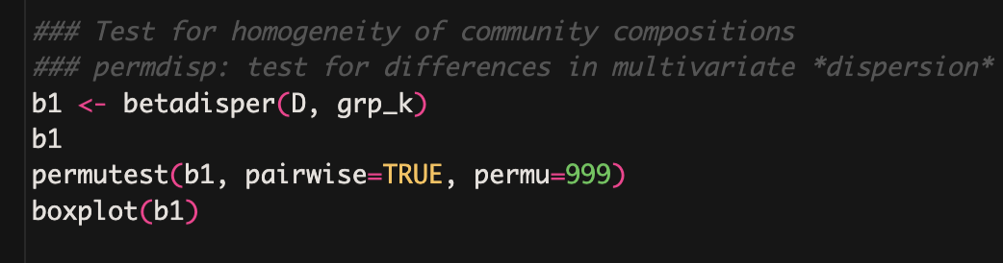
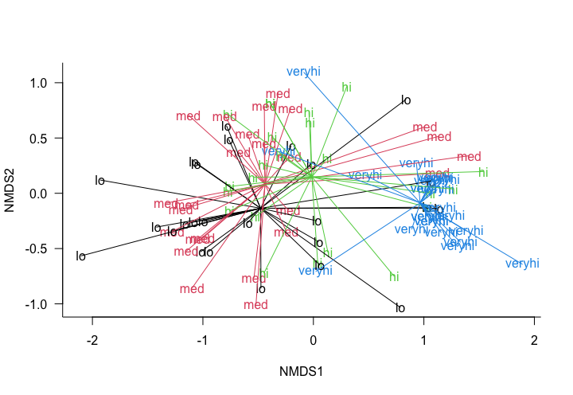
Group differences - PERMDISP
Tests for differences in group dispersion, e.g., are groups equally heterogeneous in species composition?
Example: separating plots into four groups based on quartiles of K levels (low, med, high, very high)
Syntax is similar to linear models:
Species.matrix ~ Predictor1 + Predictor2

Slide 45
Ordination, PERMANOVA and PERMDISP breakout group
Are there significant differences in plant species composition associated with the K (potassium) gradient?
Are plant communities equally heterogeneous across the K (potassium) gradient?
Can we learn anything else by examining the diagrams from the six types of ordination we have tried so far?
Do different ordination diagrams give different messages, and if so, how do we know which are more accurate?

Slide 46
Data viz Tips
The insights you gain through statistics don’t mean much unless you communicate them effectively
Teasing out a clear, compelling story from large, messy community datasets is crucial

Slide 47
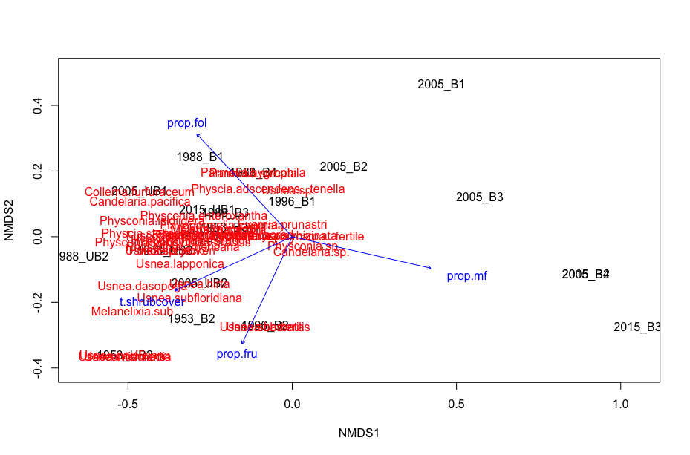

Slide 49




We’re trying to tell a story: Make it easy for the viewer to follow it
Every figure should contribute substantially to story
Otherwise drop it or move to supplement
Keep figures simple
Highlight main messages
Use consistent color scheme throughout paper / presentation

Slide 50
Making good figures takes time
I often spend 2-6+ hours on a single figure for a publication
Keep in mind you may have to revise figures
Try to use reproducible workflow—doing it all in R is usually best

Slide 51
Color schemes
Complementary colors
Lots of color palettes for R
Avoid using red & green (especially together)
Color-blind-friendly palettes are available with shades of red and green

Slide 52
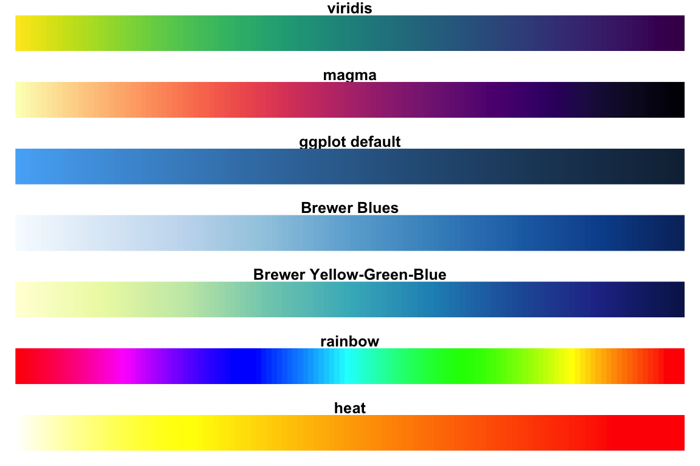
What is the one best color palette for R?

Slide 53
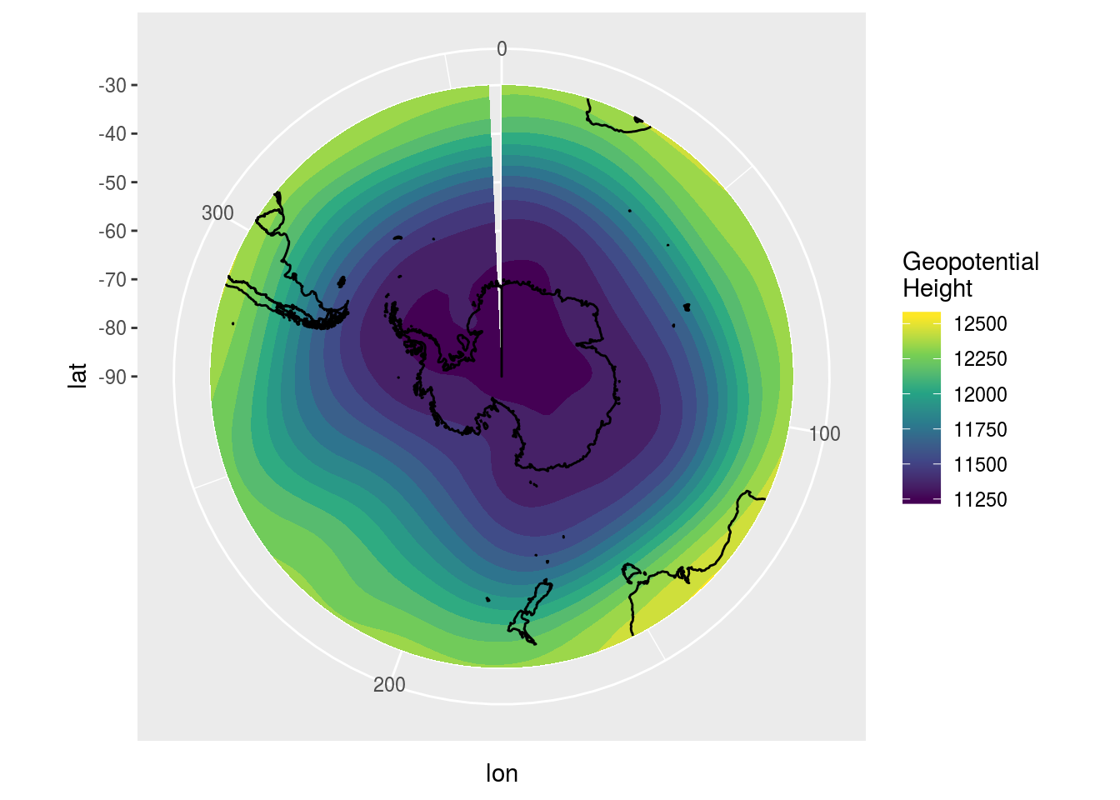
Viridis

Slide 54
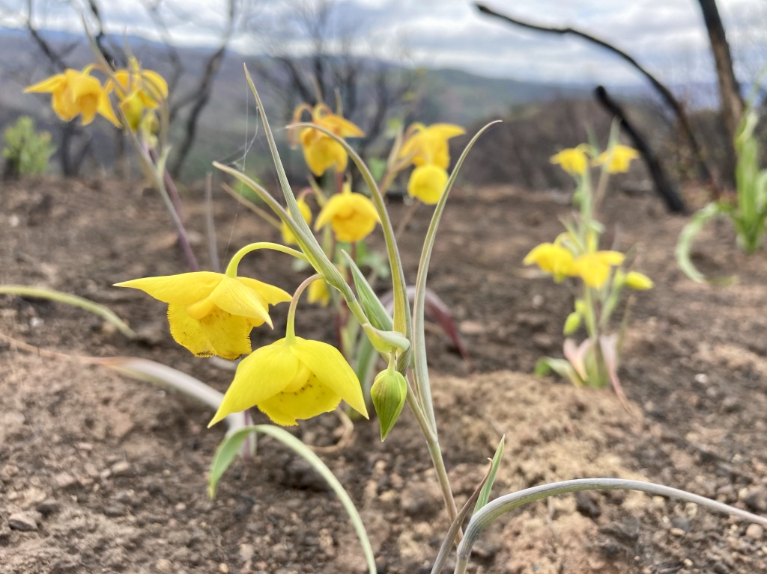
Indicator Species Analysis
Testing whether certain species are associated with distinct groups of plots
We use predetermined plot groupings—here we will separate the plots into K (potassium) quartiles again
IRL, many possibilities: burned / unburned; time since fire; fire severity classes; different management histories

Slide 55
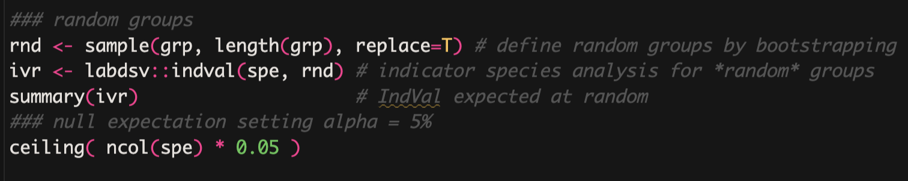
Indicator Species Analysis
We can also run an indicator species analysis with randomly selected groups (why would we want to do that?)

Slide 56
Breakout group: indicator species analysis
Are there plants that are significant indicators of different soil potassium levels?
Try running indicator species analysis with a different environmental variable, discuss what you found
Advanced question: which environmental variable has the most significant indicator species when seprated into quartiles?

Slide 57
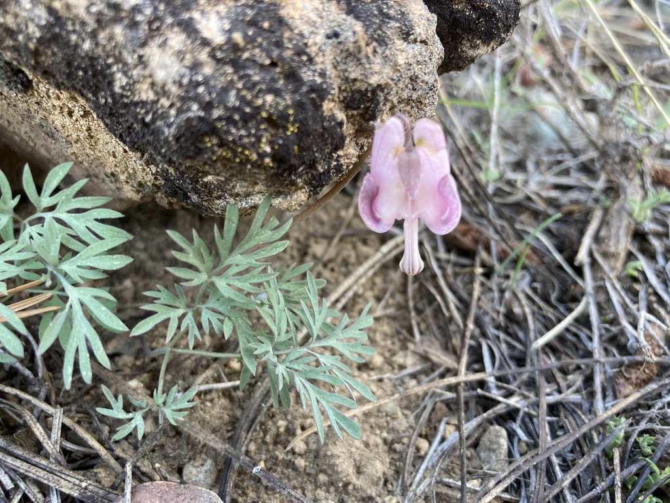
Trait-environment analyses
Example: How does average plant height respond to the soil K (potassium) gradient?
Trait-environment relationships are often of interest but challenging to address – traits measured at the species scale; environmental vars measured at plot scale
Three main types of approach (next slide)

Slide 58
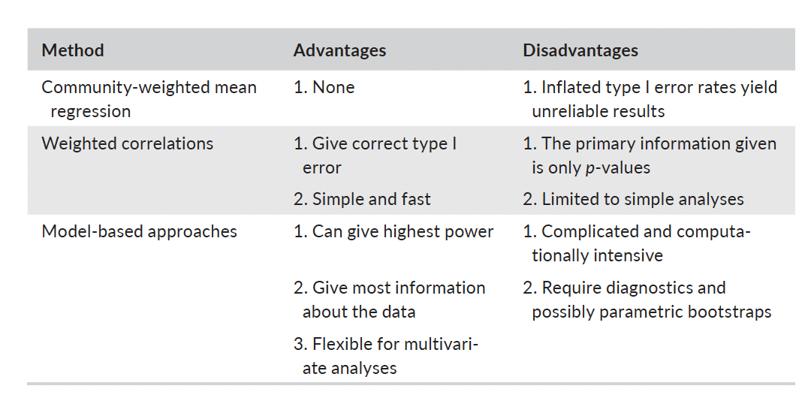
(including 4th corner analyses)
Miller et al. 2019. Functional traits and community composition: A comparison among community-weighted means, weighted correlations, and multilevel models. Methods in Ecology and Evolution.

Slide 59
Let’s compare two different methods for analyzing trait-environment relationships: 1. Community-weighted mean regression 2. Linear mixed models
Do we get the same results?
Two questions:
1. Does soil K (potassium) affect lfp?
1. Does soil K (potassium) affect spikiness?

Slide 60
Breakout group Trait-environment relationships
Develop your own hypothesis about a trait – environment relationship using this dataset, then test it.
Consider comparing CWM regression with linear mixed models like we did above!

Slide 61
Phylogenetic analyses
Why would ecologists want to consider phylogentic relationships in community analyses?

Slide 62
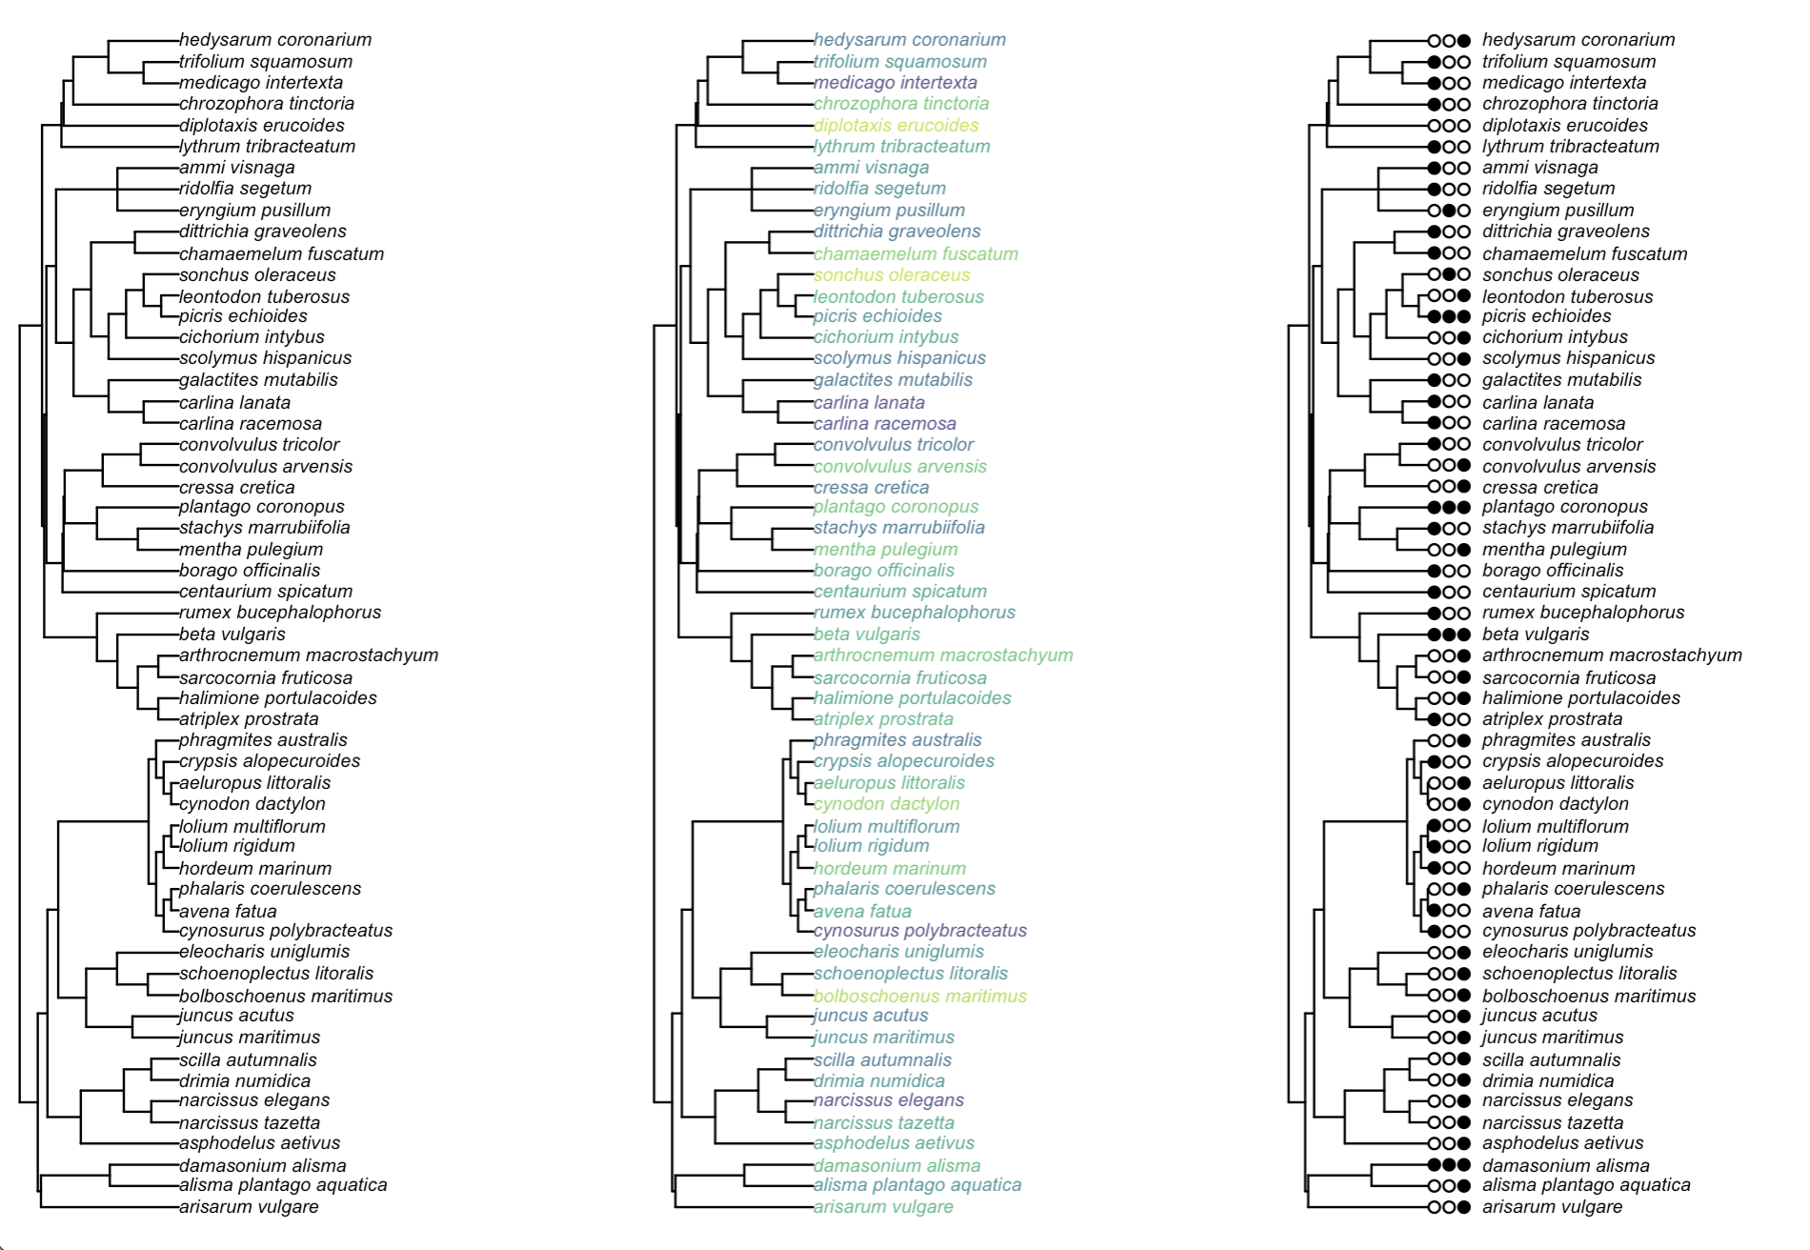

Slide 65
Phylogenetic analyses
Calculating phylogenetic metrics (individual variables) is the simplest way to include phylogeny in a community analysis
Examples:
Mean pairwise tip distance (MPD)
Mean nearest taxon distance (MNTD)
Standard effect size of MPD (SES.MPD)
Standard effect size of MNTD (SES.MNTD)
All of the above are measures of how much phylogenetic diversity is data set; consider looking at multiple metrics

Slide 66
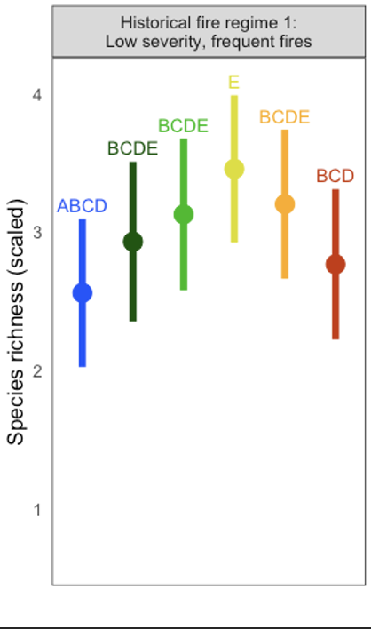
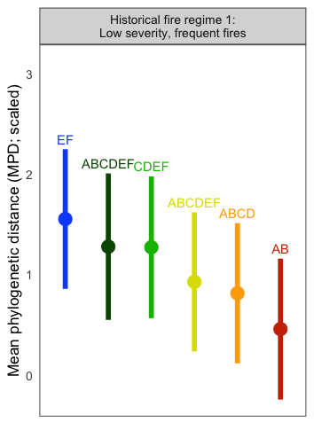
Example: effects of fire severity on plant species richness and MPD in Sierra Nevada conifer forests

Slide 67
Phylogenetic generalized linear mixed models PGLMMs
Allow analysis of trait-environment interactions while controlling for phylogenetic relationships
(not covered in our code)
See paper by Tony Ives

Slide 68
Breakout group
How do you think plant phylogenetic diversity will respond to environmental gradients in this data set?
Create a hypothesis and test it

